Slide 1
A common neural basis for contrast and motion coherence discrimination
Dan Birman
Frisem 2017-06-26

Slide 4
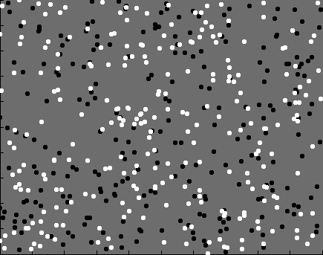

Slide 5
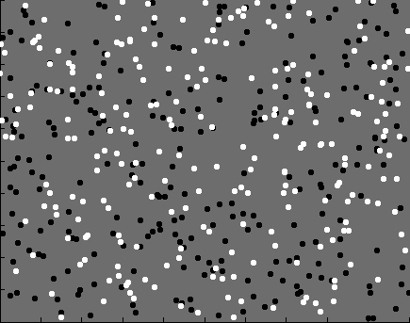
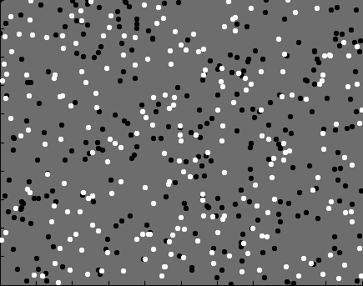
Contrast

Slide 6
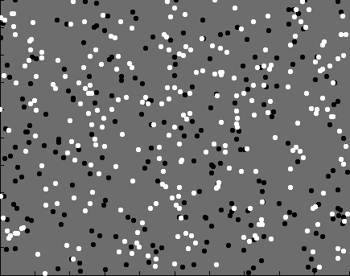
Coherence

Slide 7


Slide 8
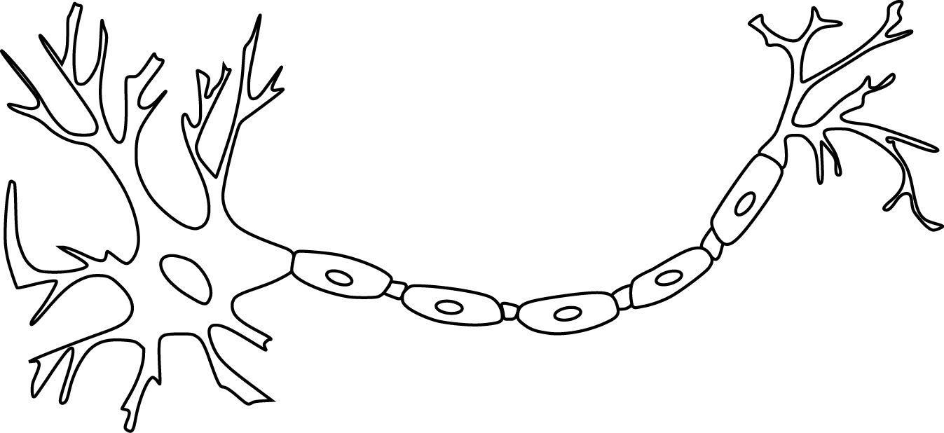

Slide 10
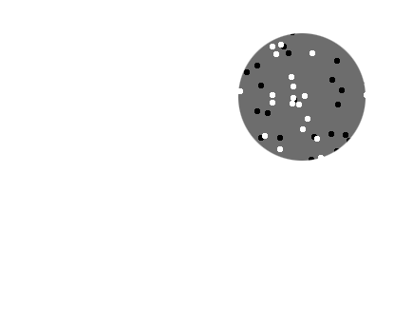
Receptive field

Slide 11
Receptive field

Slide 12
Population
Receptive field

Slide 14
~ 2.5 mm
~ 2.5 mm
~ 2.5 mm

Slide 15
~ 2.5 mm
~ 2.5 mm
~ 2.5 mm
Millions of neurons

Slide 17
Representation of contrast?
Boynton et al. 1999

Slide 18
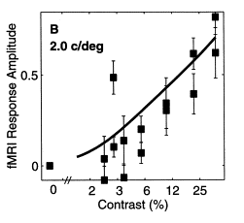
Representation of contrast?
Boynton et al. 1999

Slide 19
Representation of contrast?
Boynton et al. 1999
Representation of coherence?
Rees and Koch 2000

Slide 20
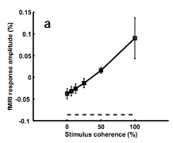
Representation of contrast?
Boynton et al. 1999
Representation of coherence?
Rees and Koch 2000

Slide 21
Representation of contrast?
Boynton et al. 1999
Representation of coherence?
Rees and Koch 2000

Slide 24
Contrast

Slide 25
Contrast

Slide 26
Contrast

Slide 27
Contrast
Coherence

Slide 28
Contrast
Coherence

Slide 29
Contrast
Coherence

Slide 30
Contrast
Coherence

Slide 31
Goal: A model of how voxels represent (encode) contrast and motion coherence

Slide 32
Goal: A model of how voxels represent (encode) contrast and motion coherence
Voxel representation from cortical measurements of BOLD fMRI
Prediction and comparison to a behavioral measure of visibility

Slide 33
Goal: A model of how voxels represent (encode) contrast and motion coherence
Voxel representation from cortical measurements of BOLD fMRI
Prediction and comparison to a behavioral measure of visibility

Slide 34
Goal: A model of how voxels represent (encode) contrast and motion coherence
Voxel representation from cortical measurements of BOLD fMRI
Prediction and comparison to a behavioral measure of visibility

Slide 38
Luminance changes = bad

Slide 44
Cortical measurements: task at fixation

Slide 45
Cortical measurements: task at fixation
11 observers, asynchronous task at fixation
800+ trials (20 per experimental condition)
1 hr retinotopy
4 x 2 hr scanning sessions

Slide 46
Area V1
Area MT

Slide 48
Within-subject analysis: display average across subjects

Slide 49
Within-subject analysis: display average across subjects
Timecourses were averaged across ROIs

Slide 50
Within-subject analysis: display average across subjects
Timecourses were averaged across ROIs
Deconvolution (GLM/finite impulse response) used to obtain separated per-condition measurements

Slide 52
Contrast

Slide 53
Contrast
Coherence

Slide 54
Contrast
Stimulus length
Coherence

Slide 68
Contrast

Slide 69
Contrast
Coherence

Slide 70
Contrast
Stimulus length
Coherence

Slide 73
Neural response model for cortical measurements

Slide 76
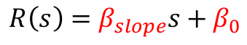
$$R\left(s\right)=β_{slope}s+β_{0}$$
Feature strength

Slide 77
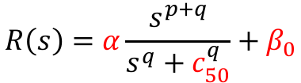
$$R\left(s\right)=β_{slope}s+β_{0}$$
$$R\left(s\right)=α\frac{s^{p+q}}{s^{q}+c_{50}^{q}}+β_{0}$$
Feature strength

Slide 78

$$R_{onset}$$
$$R\left(s\right)=β_{slope}s+β_{0}$$
$$R\left(s\right)=α\frac{s^{p+q}}{s^{q}+c_{50}^{q}}+β_{0}$$
Feature strength

Slide 80
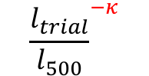
$${\frac{l_{trial}}{l_{500}}}^{−κ}$$

Slide 81
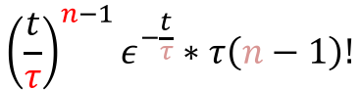
$${\left(\frac{t}{τ}\right)}^{n−1}ε^{−\frac{t}{τ}}∗τ\left(n−1\right)!$$

Slide 101
Goal: A model of how voxels represent (encode) contrast and motion coherence
Voxel representation as measured from cortical signals with fMRI
Prediction and comparison to a behavioral measure of visibility

Slide 102
Goal: A model of how voxels represent (encode) contrast and motion coherence
Voxel representation as measured from cortical signals with fMRI
Prediction and comparison to a behavioral measure of visibility

Slide 105
11 fMRI observers, 21 behavioral observers (1000—2500 trials)

Slide 123
Neural response model for behavioral measurements

Slide 127
$$r_{trial}=β_{con}R\left(Δs_{con}\right)+β_{coh}R\left(Δs_{coh}\right)+β_{bias}$$

Slide 130
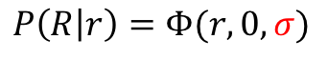
$$P\left(R | r\right)=Φ(r,0,σ)$$

Slide 131
Smaller sigma
(less noise)

Slide 132
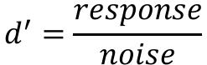
$$d^{′}=\frac{response}{noise}$$
Smaller sigma
(less noise)

Slide 134
Response model:
Linear vs. nonlinear

Slide 135
Response model:
Linear vs. nonlinear

Slide 136
Response model:
Linear vs. nonlinear

Slide 137
Response model:
Linear vs. nonlinear
Noise model:
Additive vs. poisson

Slide 138
Response amplitude (s.d.)
Stimulus strength (%)

Slide 139
Response amplitude (s.d.)
Stimulus strength (%)

Slide 140
Response amplitude (s.d.)
Stimulus strength (%)

Slide 141
Response amplitude (s.d.)
Stimulus strength (%)

Slide 142
Response amplitude (s.d.)
Stimulus strength (%)

Slide 143
Response amplitude (s.d.)
Stimulus strength (%)

Slide 144
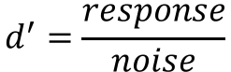
Response amplitude (s.d.)
$$d^{′}=\frac{response}{noise}$$
Stimulus strength (%)

Slide 145
Response amplitude (s.d.)
$$d^{′}=\frac{response}{noise}$$
Stimulus strength (%)

Slide 150
Response amplitude (s.d.)
Stimulus strength (%)

Slide 151
Response amplitude (s.d.)
$$d^{′}=\frac{response}{noise}$$
Stimulus strength (%)

Slide 155
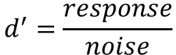
Response amplitude (s.d.)
$$d^{′}=\frac{response}{noise}$$
Stimulus strength (%)

Slide 159
For each response model: which noise model fits best?

Slide 160
0
Naka-Rushton response
Linear response
0
0
Noise model
Noise model

Slide 161
0
Naka-Rushton response
Linear response
0
0
Noise model
Noise model

Slide 162
0
Naka-Rushton response
Linear response
0
Noise model
Noise model

Slide 163
Naka-Rushton response
Linear response
0
0
Noise model
Noise model

Slide 164
Naka-Rushton response
Linear response
0
0
Noise model
Noise model

Slide 165
Naka-Rushton response
Linear response
0
Noise model
Noise model

Slide 166
For each subject: which model fits best?

Slide 167
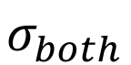
$$σ_{both}$$
0
Response model
0
Response model
0
0
Noise model
Noise model

Slide 168
$$σ_{both}$$
0
Response model
Response model
0
0
0
Noise model
Noise model

Slide 169
$$σ_{both}$$
0
Response model
Response model
0
0
0
Noise model
Noise model

Slide 170
$$σ_{both}$$
0
Response model
Response model
0
0
Noise model
Noise model

Slide 171
$$σ_{both}$$
0
Response model
Response model
0
Noise model
Noise model

Slide 172

$$σ_{both}$$
$$σ_{contrast},σ_{coherence}$$
Response model
0
Response model
0
Noise model
Noise model

Slide 173
$$σ_{both}$$
$$σ_{contrast},σ_{coherence}$$
Response model
Response model
0
0
Noise model
Noise model

Slide 174
$$σ_{both}$$
$$σ_{contrast},σ_{coherence}$$
Response model
Response model
0
0
Noise model
Noise model

Slide 175
$$σ_{both}$$
$$σ_{contrast},σ_{coherence}$$
Response model
Response model
0
0
Noise model
Noise model

Slide 176
$$σ_{both}$$
$$σ_{contrast},σ_{coherence}$$
Response model
Response model
0
Noise model
Noise model

Slide 177
Goal: A model of how voxels represent (encode) contrast and motion coherence
Voxel representation as measured from cortical signals with fMRI
Prediction and comparison to a behavioral measure of visibility

Slide 178
Goal: A model of how voxels represent (encode) contrast and motion coherence
Voxel representation as measured from cortical signals with fMRI
Prediction and comparison to a behavioral measure of visibility

Slide 179
Goal: A model of how voxels represent (encode) contrast and motion coherence
Voxel representation as measured from cortical signals with fMRI
Evidence for similar neural response functions to contrast and motion coherence
Prediction and comparison to a behavioral measure of visibility

Slide 180
Goal: A model of how voxels represent (encode) contrast and motion coherence
Voxel representation as measured from cortical signals with fMRI
Evidence for similar neural response functions to contrast and motion coherence
Prediction and comparison to a behavioral measure of visibility

Slide 181
Goal: A model of how voxels represent (encode) contrast and motion coherence
Voxel representation as measured from cortical signals with fMRI
Evidence for similar neural response functions to contrast and motion coherence
Prediction and comparison to a behavioral measure of visibility
Judgments of contrast and motion coherence appear to be read out from early visual cortex and MT in a similar way

Slide 182
Goal: A model of how voxels represent (encode) contrast and motion coherence
Voxel representation as measured from cortical signals with fMRI
Evidence for similar neural response functions to contrast and motion coherence
Prediction and comparison to a behavioral measure of visibility
Judgments of contrast and motion coherence appear to be read out from early visual cortex and MT in a similar way
but with some variability across subjects

Slide 183

Thanks!
Another person involved in this project:
Justin Gardner

